Slide 1


An Introduction to Academic Integrity and Plagiarism Avoidance
writingsupport@uwindsor.ca
Writing Support Desk

Slide 2
Academic Integrity
“Academic Integrity” refers to a code of conduct that establishes trust and rigor in academic work, as well as an environment conducive to scholarly collaboration and the dissemination of knowledge and understanding.
Universities generally, as well as members of faculty and students, all depend on this set of mores that govern scholarly conduct and communication in order to maintain honesty, rigor and fairness across the entire academic community.
Without these standards the value of both university degrees and scholarship would be highly suspect.

Slide 3
The Office of Academic Integrity at the University of Windsor expands on this notion:
As noted in the Student Code of Conduct, by accepting admission into the academic community at the University of Windsor, students have an obligation to conform to standards of behavior (both academic and non-academic) that benefit all members of the academic community.
“Academic integrity is more than just plagiarism and cheating. It means centering your academic journey around the core values of honesty, respect, fairness, and responsibility.
At the University of Windsor, we expect our students, faculty, and staff to contribute to a positive environment where academic integrity is upheld in all of our work.”
(www.uwindsor.ca/academic-integrity/)

Slide 4

There are two formal rule structures that cover student conduct and demand intellectual honesty at the University of Windsor.
The Student Code of Conduct
And
Senate Bylaw 31
6

Slide 5


The Student Code of Conduct is an agreement that, by accepting admission into the academic community at the University of Windsor, governs students’ behavior (both academic and non-academic, and on-campus and off).
It lays out standards for conduct that aim to establish the basis for scholarly collaboration that benefits all members of the academic community.
This is an important document and should be read carefully by every student.
4

Slide 6
Senate Bylaw 31 addresses the subject of academic integrity as it pertains to student conduct.
The Bylaw notes that “…students are … expected to conduct themselves with integrity as illustrated by the codes of conduct established by their professional discipline and the Senate Student Code of Conduct.
Any student whose conduct exhibits a lack of integrity, as defined in this bylaw and in related Senate and University bylaws and policies, shall be disciplined in the interest of safeguarding and upholding these objectives. It is the purpose of this bylaw to set out a fair and equitable process by which these standards are upheld.”
6

Slide 7
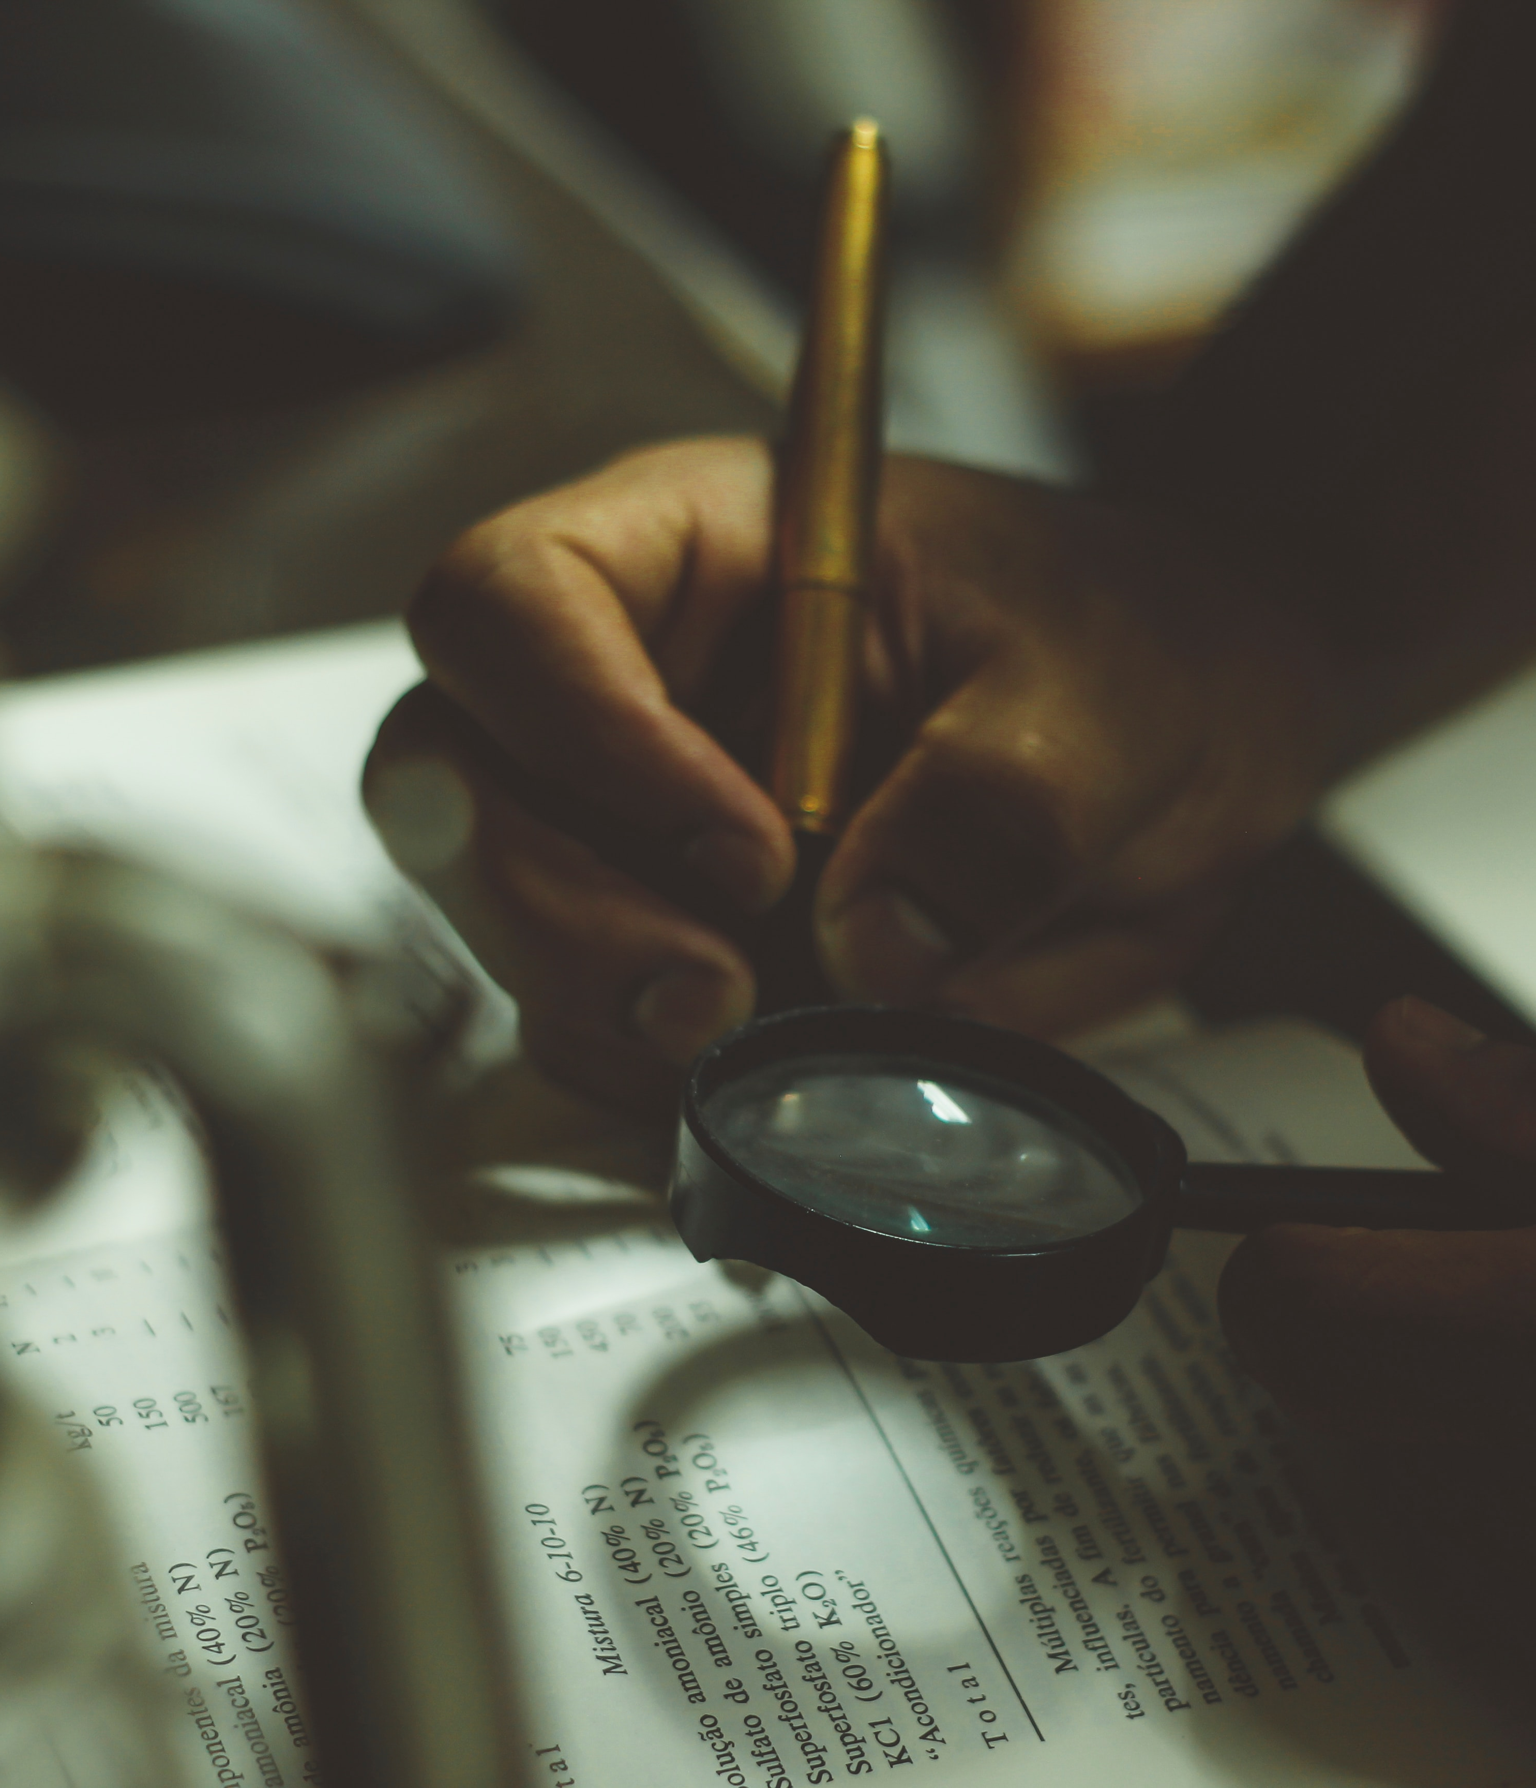
In the end, academic integrity is about honesty, respect, and participation in a community of researchers.
It is not surprising, then, that University of Windsor treats academic integrity violations very seriously.
6

Slide 8

The Student Code of Conduct and Bylaw 31 work together to address issues such as
Plagiarism
Submitting false, fraudulent, or purchased assignments, research or credentials.
Impersonating another or permitting someone to impersonate you, either in person or electronically, for academic assessment or in order to improperly gain access to services.
Submitting the same work … for credit on more than one occasion without the prior written permission of the instructor(s) in the course(s) involved.
Allowing another student to copy one’s academic work.
Breach of the Senate Policy on the Conduct of Exams and Tests.
(See section 3 of the Code of Conduct for a complete list)
6

Slide 9
Plagiarism
The full definition of plagiarism can be found in Section 2 (i) of the Student Code of Conduct. It states:
“Plagiarism: the act of copying, reproducing or paraphrasing significant portions of one’s own work, or someone else's published or unpublished material (from any source, including the internet), without proper acknowledgment, representing these as new or as one's own.
Plagiarism applies to all intellectual endeavors: creation and presentation of music, drawings, designs, dance, photography and other artistic and technical works.
(Students have the responsibility to learn and use the conventions of documentation as accepted in their area of study and instructors have the responsibility of informing students in writing of any significant individual interpretations of plagiarism.)” (2016)

Slide 10
Plagiarism vs. Research
Both plagiarism and academic research make use of sources.
Researchers meticulously document their sources and make clear distinctions between the work that has come before and what the researcher is adding to the discussion.
Plagiarists, however, fail to give proper credit to their sources.
It should be noted that using sources in your research is encouraged.
Universities invest a great deal of resources in maintaining libraries and a good deal of the training university students receive trains them to do research.
Academic disciplines build on the foundation of previous research to propel inquiry forward.
While the researcher employs rigorous methods to ensure honesty and transparency, what the plagiarist does is deceptive.

Slide 11
Intentional Plagiarism
In the worst cases of plagiarism, students sometimes buy a paper from the internet and hand it in as though it is their own work.
Frequently, when pressed for time or when suffering from a lack of confidence, students will be tempted to appropriate words or ideas from external sources in order to complete their assignments.
Even if a student paraphrases, condenses or selects from another person’s work, these words and ideas still belong to the original author and failing to properly credit the original source is a misrepresentation of the student’s actual work and a case of plagiarism.
This becomes a problem when students present the words or ideas taken from external sources as though they are their own.

Slide 12
Unintentional Plagiarism
Examples of Unintentional Plagiarism
Sometimes plagiarism is an intentional act and a case of deliberate cheating.
Failure to cite a source that is not common knowledge.
However, not all acts of plagiarism are malicious; some result from careless academic work.
Failure to "quote" or block quote author's exact words, even if cited.
Failure to put a paraphrase in your own words, even if cited.
Even if students do not intend to cheat, it is their responsibility to properly document any source that they use and to adhere to current scholarly procedures.
Failure to put a summary in your own words, even if cited.
Failure to be loyal to a source.

Slide 13

As noted by the Office of Academic Integrity at the University of Windsor, it is the student's responsibility
1. to learn and use writing formats as required by their academic discipline
and
2. if you are unsure what constitutes plagiarism, to contact your professor or TA/GA.
6

Slide 14
Need more help?
To book an appointment, please follow these instructions:
Visit https://success.uwindsor.ca.
Log in with your UWin ID and password.
Select Writing Support.
Select Appointments.
Select View Calendar.
Select an appointment that works for you.
Fill out what you want help with and select Book Appointment.
It is best to book a week or more in advance.
Contact Writing Support!
Writing support holds workshops on APA, MLA, Chicago Manual, and IEEE.
We also have PowerPoint and video tutorial resources which you might find helpful through our Blackboard page.
Also, you can always book an appointment with one of our academic writing advisors.

Slide 15
Thank you.
writingsupport@uwindsor.ca

